Slide 1

CHURNING CUSTOMERS
Bellevue University
DSC680
Dhiraj Bankar

Slide 2
PREDICT CHURNING CUSTOMERS

Slide 3

Context
A manager at the bank is disturbed with more and more customers leaving their credit card services.
Motive of this model to predict for them who is going to get churned so they can proactively go to the customer to provide them better services and turn customers' decisions in the opposite direction.
Notes:
A manager at the bank is disturbed with more and more customers leaving their credit card services. They would really appreciate if one could predict for them who is going to get churned so they can proactively go to the customer to provide them better services and turn customers' decisions in the opposite direction Predict Churning Customers 4
I got this dataset from a website with the URL as https://leaps.analyttica.com/home. I have been using this for a while to get datasets and accordingly work on them to produce fruitful results. The site explains how to solve a particular business problem.
Now, this dataset consists of 10,000 customers mentioning their age, salary, marital_status, credit card limit, credit card category, etc. There are nearly 18 features.
We have only 16.07% of customers who have churned. Thus, it's a bit difficult to train our model to predict churning customers.

Slide 4
Abstract
Finding the hidden information and create a machine learning model is the goal of this project.
Took the credit card of a bank, where the a manager at the bank is disturbed with more and more customers leaving their credit card services.
They would really appreciate if one could predict for them who is going to get churned so they can proactively go to the customer to provide them better services and turn customers' decisions in the opposite direction.
End of this project I will create a model where it can predict the customers who is going to get churned.

Slide 5
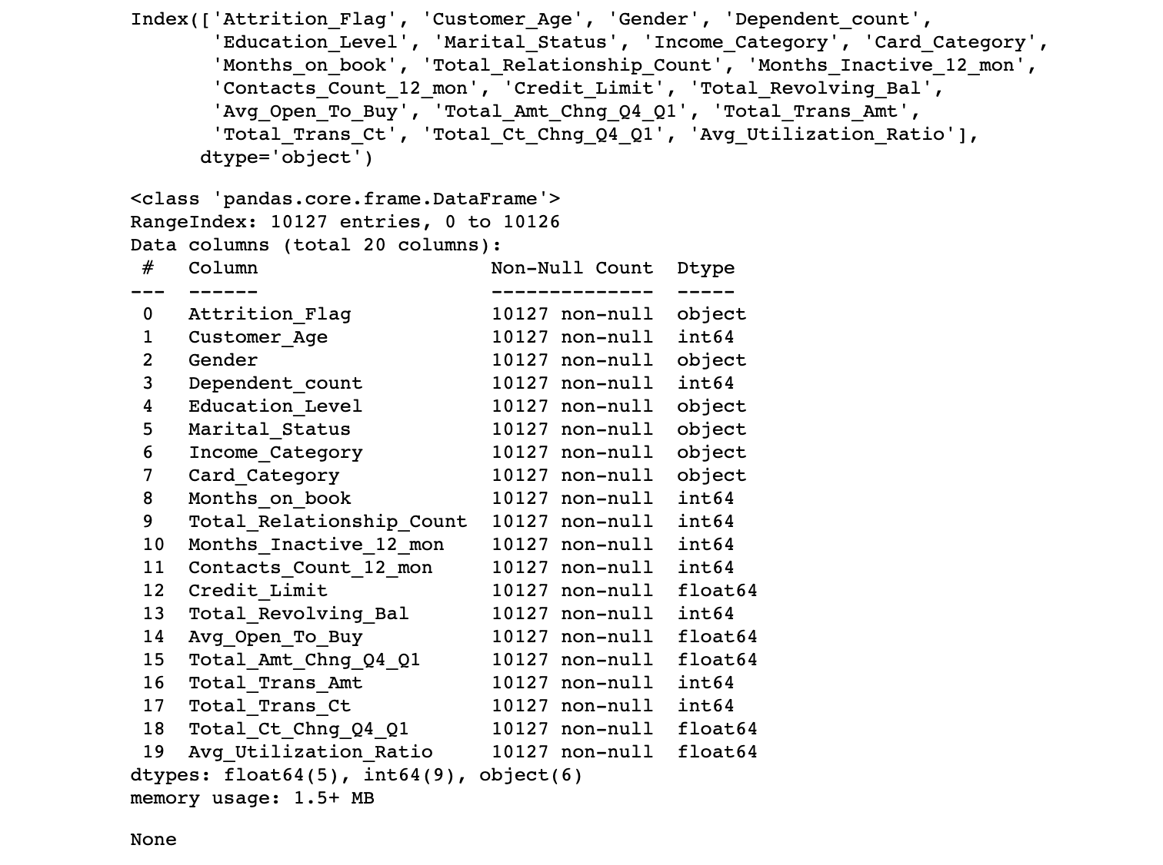
Exploratory Data Analysis
Categorical Features

Slide 6
Exploratory Data Analysis
Categorical Features
• Attrition_Flag (1: Existing Customer, 0: Attrited Customer): The Customer leave or not
• Gender (1: Male, 0: Female)
• Education_Level (Graduate , High School, Unknown, Uneducated, College, Post-Graduate, Doctorate)
• Marital_Status (Married, Single, Unknown, Divorced)
• Income_Category (Less than 40K, 40K - 60K, 80K - 120K, 60K - 80K, Unknown, 120K +) in dollar
• Card_Category (Blue, Silver, Gold, Platinum)

Slide 7
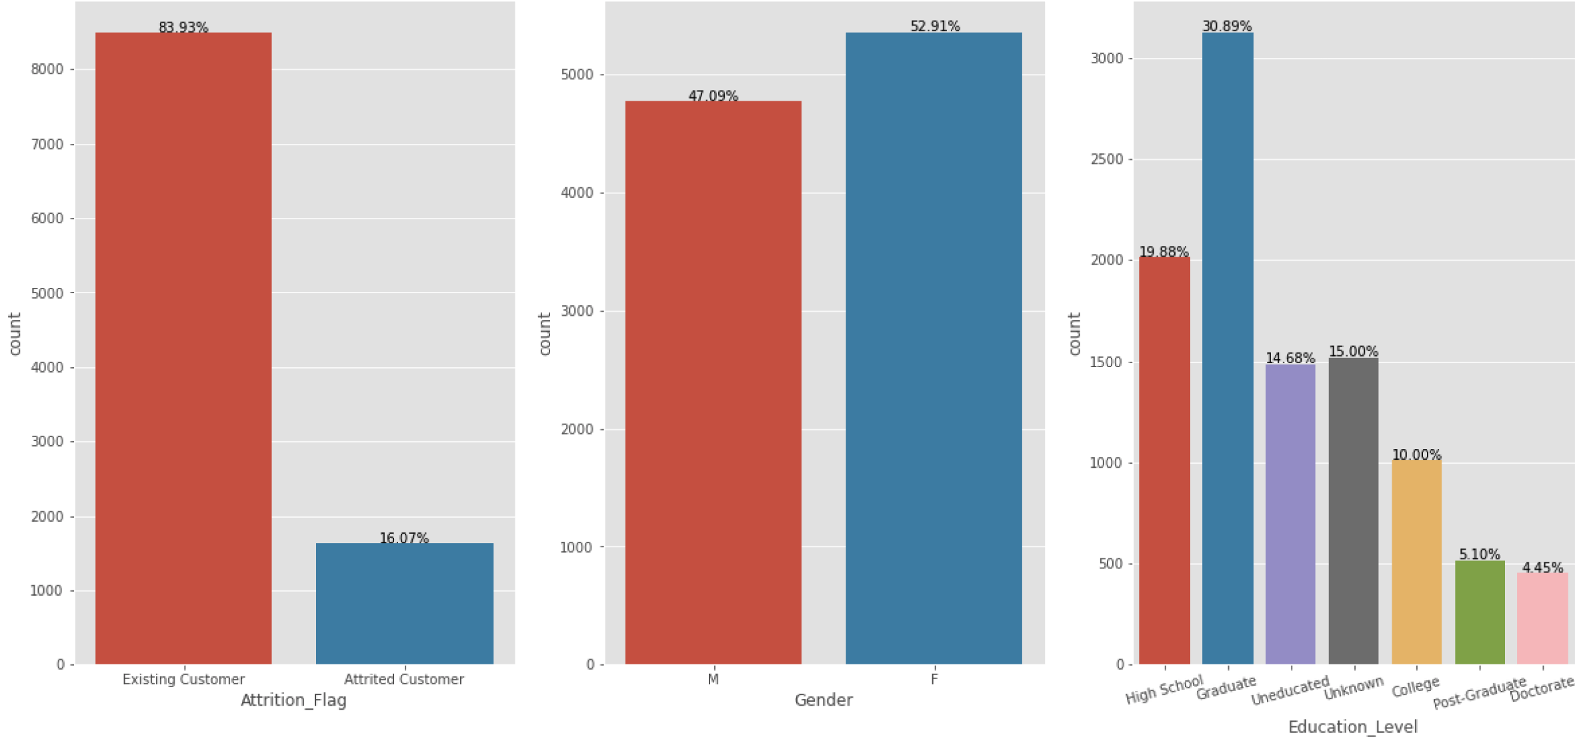
Exploratory Data Analysis
Count plots for Categorical Features

Slide 8
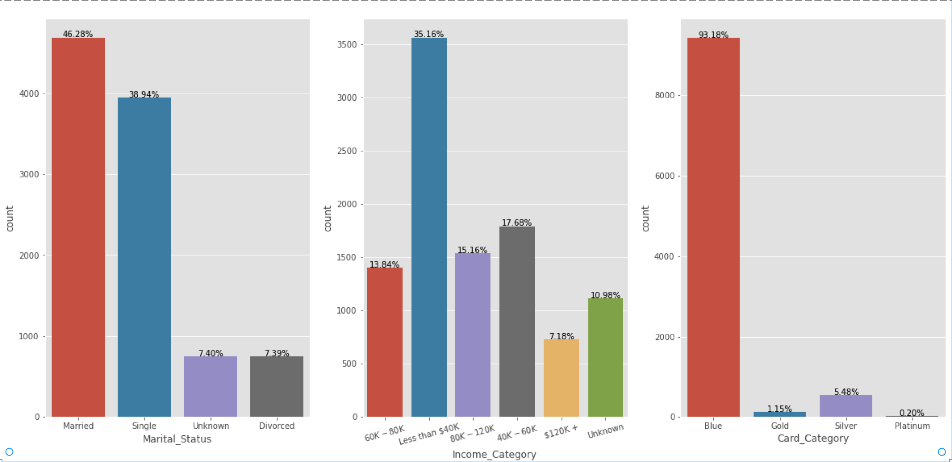
Exploratory Data Analysis
Count plots for Categorical Features

Slide 9
Exploratory Data Analysis
Attried customers by Categorical Features and plot the count plot for it

Slide 10
Exploratory Data Analysis
Numerical Features
• Customer_Age: Customer's Age in Years
• Dependent_count: Number of dependents
• Months_on_book: Period of relationship with bank
• Total_Relationship_Count: Total no. of products held by the customer
• Months_Inactive_12_mon: No. of months inactive in the last 12 months
• Contacts_Count_12_mon: No. of Contacts in the last 12 months
• Credit_Limit: Credit Limit on the Credit Card
• Total_Revolving_Bal: Total Revolving Balance on the Credit Card
• Avg_Open_To_Buy: Open to Buy Credit Line (Average of last 12 months)
• Total_Amt_Chng_Q4_Q1: Change in Transaction Amount (Q4 over Q1)
• Total_Trans_Amt: Total Transaction Amount (Last 12 months)
• Total_Trans_Ct: Total Transaction Count (Last 12 months)
• Total_Ct_Chng_Q4_Q1: Change in Transaction Count (Q4 over Q1)
• Avg_Utilization_Ratio: Average Card Utilization Ratio

Slide 11
Exploratory Data Analysis
Histogram for all Numerical features

Slide 12
Feature selection

Slide 13
Model selection and Results
Notes:
I selected LogisticRegression, RandomForestClassifier and GaussianNB models and compared the accuracy of each model for Train dataset and Test dataset and produces comparison results.
From the bellow graphs the RenadomForestClassifer has highest accuracy and Logistic Regression has lowest accuracy. In next ween I will represent the feature selection by each module.
Train- {'LogisticRegression': 0.880951878232117, 'RandomForestClassifier': 0.9120173919135198, 'GaussianNB': 0.8969981384644015}
Test- {'LogisticRegression': 0.8799261200018883, 'RandomForestClassifier': 0.9098462317553097, 'GaussianNB': 0.896910258225936}

Slide 14
Confusion matrix

Slide 15

SUMMARY
The LogisticRegression model predicted the 114 existing customer as attrited customers and 143 attrited customers as existing customer
The RandomForestClassifier model predicted the 24 existing customer as attrited customers and 215 attrited customers as existing customer
The GaussianNB model predicted the 93 existing customer as attrited customers and 224 attrited customers as existing customer
As per accuracy the RandomForestClassifier should perform best but LogisticRegression model is performing better that other models.

Slide 16

Conclusion
I am lucky, I found really nice dataset and I could analyze the data and applied all my understanding which I learnt as part of this subject. I am really happy.
As part of this analysis I used multiple models like LogisticRegression, RandomForestClassifier and GaussianNB. Overall Random Forest Classifier seems more accurate overall. It is also more accurate in Existing customer findings and not recommended to find the attrited customers. However, Logistic Regression has more accuracy in terms of True or Recommended Scenarios.
Definitely, I don't want to say my model is 100% accurate. I feel as a beginner model is really performing well. Definitely there is scope of improvement and best practices to get better results. I feel there is scope of improvement of feature selection. This could make model more tuned.
Definitely we can use this model to reduce the attrited customers and save the credit card company problem.

Slide 17
THANK YOU!
August Bergqvist
Email:
GitHub location:
dbankar@my365.Bellevue.edu
https://github.com/DhirajDataSciencePortfolio/DSC680/tree/main/Project_1/Week4

Slide 18

APPENDIX

